Slide 1
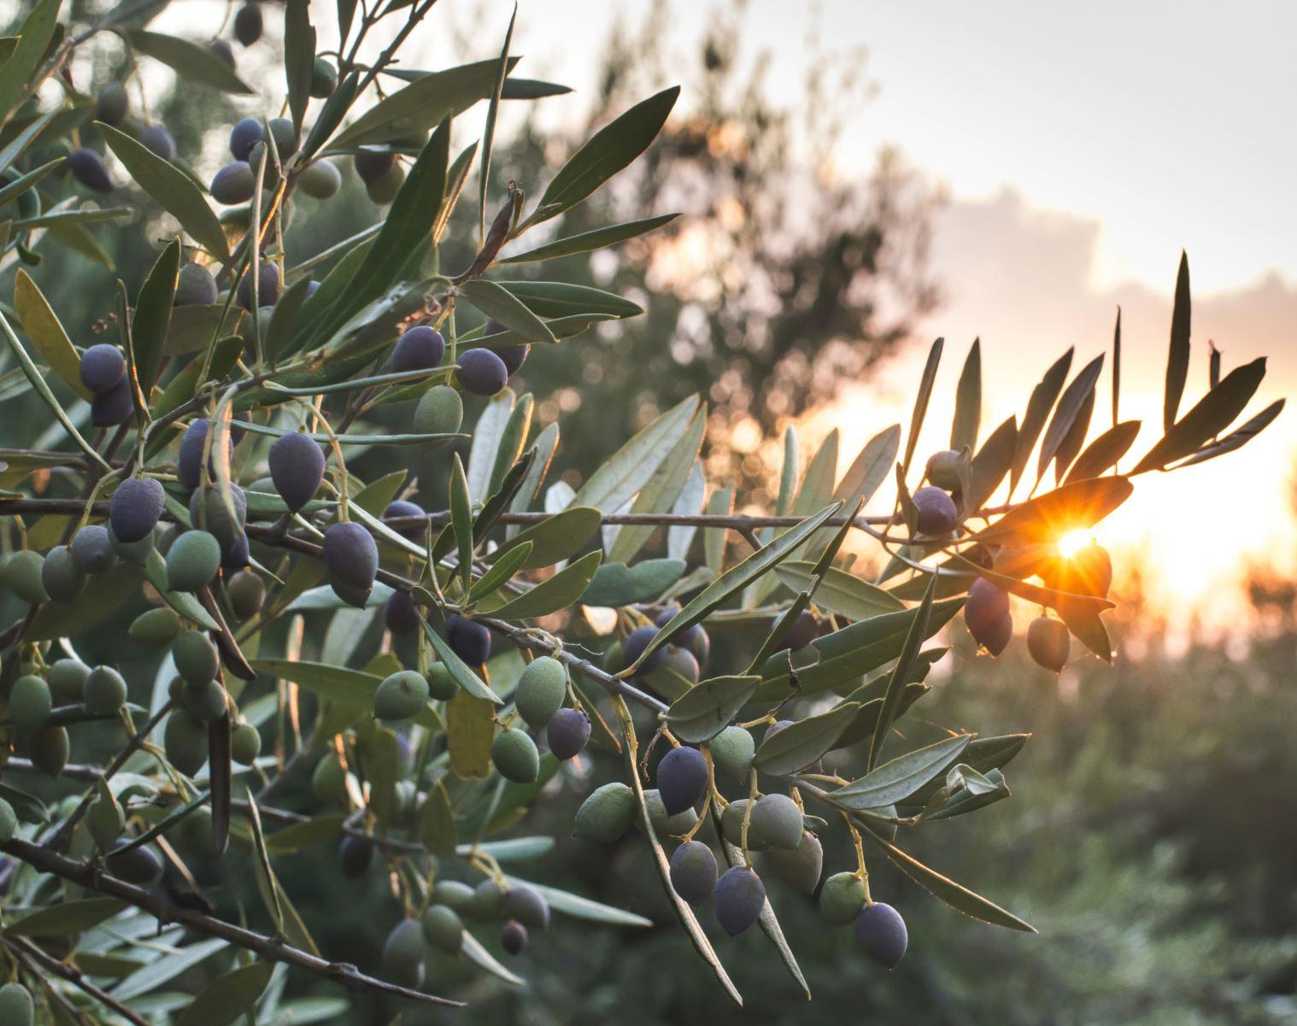
Optimizing Water Usage in Olive Trees: Leveraging Deep Learning for Sustainable Farming
Harnessing the Power of Technology for Enhanced Tree Health and Environmental Stewardship

Slide 2
Agenda
Introduction
Company Overview
Problem Statement
Data Availability
Deep Learning for Image Analysis
Proposed Approach
Justifying Deep Learning
Describing Findings
Time vs Benefit Analysis
Conclusion
Visual example

Slide 3
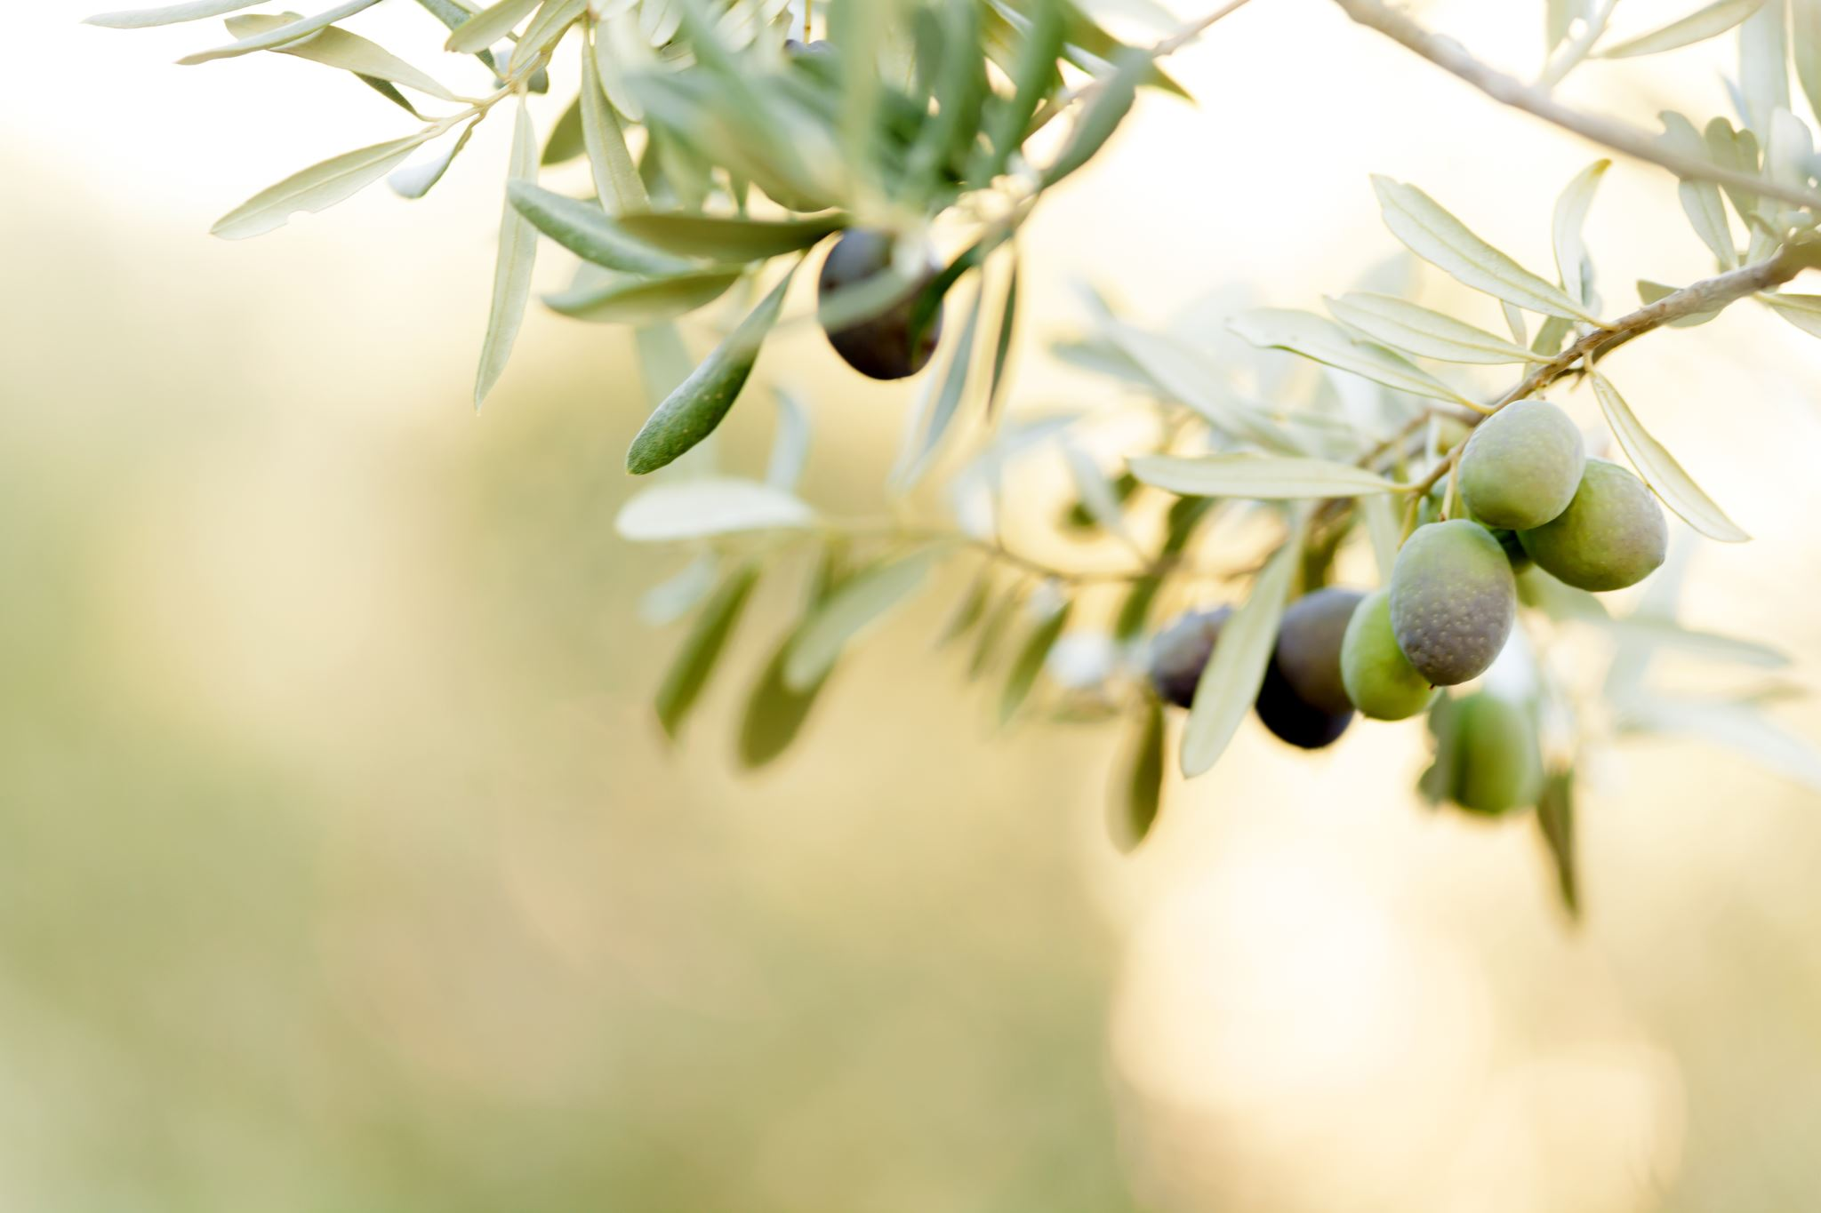
Introduction
Welcome to today's presentation on optimizing water usage in olive trees for sustainable farming. As the proud owner of an olive oil company committed to eco-friendly practices, we understand the critical importance of efficiently managing water resources for the health and productivity of our olive trees

Slide 4
Company Overview
At Olivia, we strive to produce the finest organic olive oil while preserving the environment. With a focus on sustainable farming practices, we are constantly seeking innovative solutions to optimize our water usage and ensure the long-term sustainability of our operations.

Slide 5
Problem Statement
One of the key challenges we face in our olive oil production is efficiently managing water usage in our olive trees. Finding the right balance between frequency and quantity of watering is crucial to ensure optimal tree health, productivity, and the overall sustainability of our farming operations.
Efficient water management not only helps conserve this precious resource but also directly impacts the quality of our olive oil. By optimizing water usage, we can enhance tree health, increase yield, and maintain the superior quality that our customers expect. Additionally, sustainable water practices align with the growing consumer demand for eco-friendly products.

Slide 6
Data Availability
To address the challenge of optimizing water usage, we have collected a comprehensive dataset consisting of 2000 olive trees over a span of 10 years. This dataset includes images captured at different seasons, reflecting varying watering frequencies and quantities applied to the trees.
Our dataset offers a significant amount of information, enabling us to analyze different watering scenarios and their impact on olive tree health. It covers a range of watering frequencies, from every 3 days to once every 10 days, as well as different water quantities applied.
This extensive dataset serves as a valuable resource for training a deep learning model that can learn from patterns in olive tree images and provide insights into the relationship between watering practices and tree health. Having access to this wealth of information allows us to make data-driven decisions for optimizing our water usage strategies.

Slide 7
Deep Learning for Image Analysis
To analyze the complex relationship between watering practices and olive tree health, we propose harnessing the power of deep learning. Deep learning is a subset of machine learning that utilizes neural networks with multiple layers to automatically learn and extract meaningful patterns from data.
Deep learning allows us to leverage the inherent capabilities of neural networks to automatically learn and extract intricate features from the images of our olive trees. Unlike traditional methods that require manual feature engineering, deep learning models can learn directly from the data, enabling us to capture subtle visual cues that are critical for evaluating tree health and response to watering practices.
By leveraging the deep layers of neural networks, deep learning models can learn increasingly complex features, allowing them to understand and represent the visual characteristics of our olive trees at different watering scenarios. This feature learning capability makes deep learning particularly well-suited for analyzing image data and uncovering hidden relationships.

Slide 8

Proposed Approach
To optimize water usage in our olive trees, we propose utilizing deep learning models trained on our extensive dataset. By analyzing the images of olive trees captured under various watering scenarios, these models will learn to correlate visual cues with different levels of tree health and provide insights into the impact of watering frequency and quantity.
We will train a deep neural network using our dataset, feeding it with labeled images based on watering frequency and quantity. The model will learn to capture the visual patterns associated with different watering scenarios and their effects on olive tree health.
Once trained, the deep learning model can be employed to predict the health and response of olive trees under different watering strategies. By simulating various watering scenarios, we can identify the optimal frequency and quantity of water application that promotes healthier tree growth, higher yield, and improved sustainability.

Slide 9

Justifying Deep Learning
Deep learning models excel at automatic feature extraction, eliminating the need for manual feature engineering. This allows us to capture subtle visual cues that may not be easily identifiable by traditional methods, enabling a more comprehensive analysis of the impact of watering practices on olive tree health.
1
Deep learning models can learn intricate relationships between variables, including non-linear interactions. In the context of water usage optimization, this means the model can detect nuanced effects of watering frequency, quantity, and their combined influence on the health and productivity of olive trees.
2
By leveraging the insights provided by the deep learning model, we can make informed decisions regarding optimal watering strategies. This empowers us to tailor our water usage patterns to maximize tree health, increase yield, and improve the overall sustainability of our olive oil production.
3
While deep learning models are highly effective, they can sometimes be challenging to interpret due to their complexity. However, we can overcome this challenge by providing visualizations, such as heatmaps or feature importance plots, to illustrate how the model's decisions are influenced by various watering scenarios.
4

Slide 10
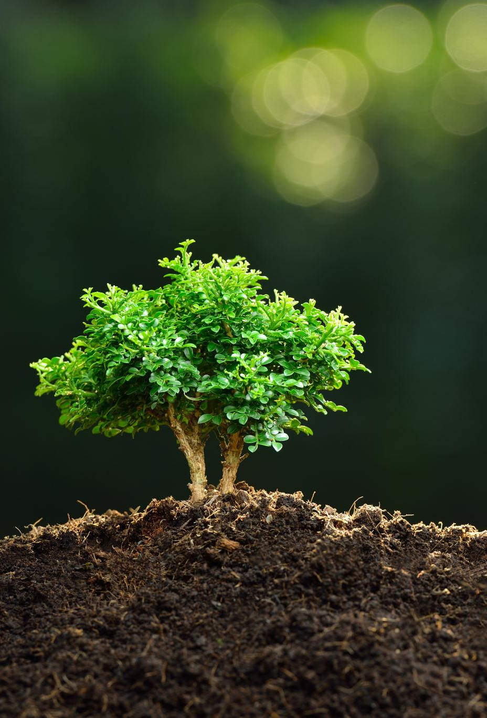
Describing Findings
The insights gained from the deep learning model can be visualized and communicated effectively to various stakeholders. Visualizations, such as heatmaps, can highlight the areas of the olive tree images that strongly correlate with different watering scenarios, making it easier to describe and interpret the impact of watering practices on tree health.
It is crucial to ensure that the findings and decisions derived from the deep learning model are easily understandable and compelling to stakeholders, including farmers, agronomists, and regulatory bodies. By providing visual evidence and clear explanations, we can build trust and confidence in the value of our water usage optimization strategies.
Transparency is key when utilizing deep learning models. We will ensure that the decision-making process of the model is transparent, providing insights into how the model weighs different features and attributes in determining optimal watering strategies. This transparency will enable us to be accountable for the decisions made based on the deep learning insights.

Slide 11

Time vs Benefit Analysis
Implementing a deep learning model for water usage optimization requires an initial investment of time and resources. This includes data preprocessing, model training, and validation. However, this investment is crucial for building a robust and accurate model that can provide valuable insights into optimizing our water usage strategies.
By leveraging the power of deep learning, we can optimize our water usage strategies, leading to improved tree health, increased yield, and enhanced sustainability. These long-term benefits not only contribute to the success of our olive oil production but also align with the growing demand for environmentally conscious and sustainable practices.
While the initial investment in a deep learning model may require time and resources, the potential return on investment can be significant. By optimizing water usage, we can minimize water waste, reduce costs, and enhance productivity, ultimately leading to improved profitability and a stronger competitive edge in the olive oil industry.

Slide 12
Conclusion
In conclusion, by harnessing the power of deep learning, we can unlock the potential for water usage optimization in our olive trees. Through analysis of our extensive dataset and the application of deep learning models, we can gain valuable insights into the impact of watering practices on tree health and productivity.
Based on our analysis, we highly recommend investing in a deep learning model to optimize water usage in our olive trees. The abundance of data, the automatic feature extraction capabilities, and the potential long-term benefits make deep learning a valuable tool for improving sustainability and productivity in our olive oil production.
Moving forward, we will proceed with data preprocessing, model training, and validation. We will then integrate the deep learning model into our water usage management system, allowing us to make data-driven decisions and implement optimized watering strategies

Slide 13
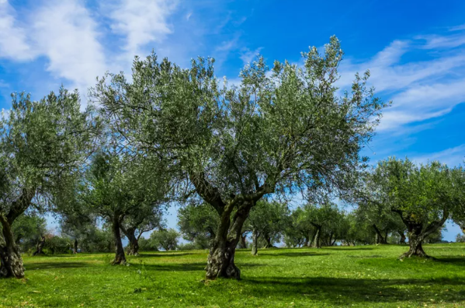
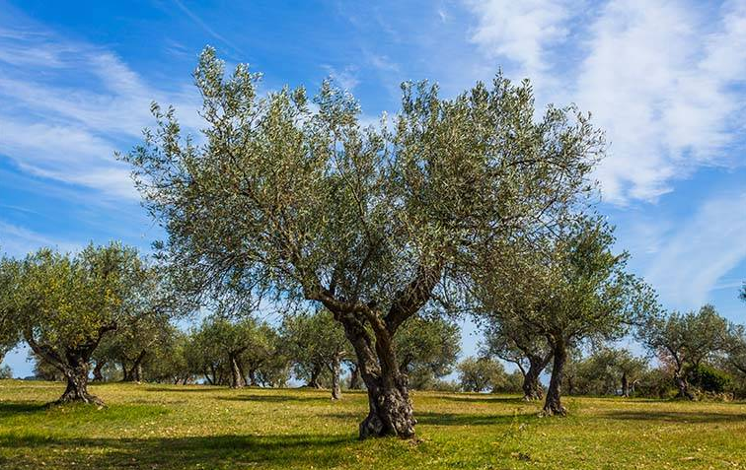
Visual Comparison: Well-Watered vs. Non-Watered Olive Trees

Slide 14

Thank you!

